Slide 1
Agile Development
Topic 1:
Introduction to the Unit and an Overview of Agile
Notes:
NCC Education - Title Master

Slide 2
Topic 1: Coverage
  This first topic is an introduction to the rest of the unit. It will:
    Provide an introduction to the structure and content of the Agile Development unit;
    Give the aim, scope and coverage of the unit;
    Introduce the history and key concepts of Agile, in comparison to the waterfall approach;
    Show the structure of DSDM.
Notes:
NCC Education - Slide Master

Slide 3
Topic 1: Agenda
  In this lecture, we will cover:
    Scope of the Agile Development unit
    What is Agile?
    Underpinning Themes
    What is Waterfall?
    What is DSDM?
    Private Study and Self Study Tasks
    Recommended Reading

Slide 4
Unit Scope and Coverage
  The Agile Development unit will:
    Provide an introduction to the principles, people, processes and practices of Agile development;
    Prepare students for future trends in software development practices;
    Reinforce understanding of the information systems development process.
Notes:
NCC Education - Slide Master

Slide 5
Unit Aim
  The Agile Development unit will:
  Introduce Agile Development;
  Provide a basic understanding of the main concepts and terminology of Agile;
  Give sufficient understanding of the lifecycle, framework, techniques to equip students to work within an Agile team.
Notes:
NCC Education - Slide Master

Slide 6
Unit Learning Outcomes – 1
  By the end of the Agile Development unit students will be able to:
    Understand the background to Agile development;
    Understand the roles within an Agile development team;
    Understand the various Agile development techniques;
    Understand an Agile development lifecycle;

Slide 7
Unit Learning Outcomes – 2
    Understand the principles associated with an Agile development approach;
    Be able to apply an Agile development approach to a particular project scenario.

Slide 8
Structure of the Unit
  Key points to consider are:
    The lectures and seminars will provide you with the underpinning knowledge you need;
    You should raise any questions you have as they arise at lectures and seminars;
    You will be set self study tasks to complete for each topic;
    You are encouraged to work together as a team to provide mutual support and assistance.
Notes:
Students are to be encouraged to complete self study tasks and these should be scheduled to be handed in by the tutor. Tasks will be conducted individually, but fed back in small groups and discussed.

Slide 9
Topics - 1
Introduction to the unit and an Overview of Agile
The Agile Approach and Principles
Modelling
Roles, Skills and Team Structures
Lifecycle and Products
Project Management Considerations (Part 1)

Slide 10
Topics - 2
Project Management Considerations (Part 2)
Facilitated Workshops
Requirements Definition and Prioritisation
Development and Prototyping
Estimating and Time boxing
Unit Summary and Revision Guidance
Each topic is typically 2 hours of lectures and 3 hours of seminars, followed by private study time.

Slide 11
Unit Assessment
  This unit is assessed by an assignment. You should plan to spend roughly 8 hours working on your assignment. You will work on it while you study the unit. The assignment is worth 100% of your overall mark for the unit.

Slide 12
Exercise 1
  Write down FIVE (5) words which you think describe Agile Development.
Notes:
Examples could be:
Creative; Flexible; Responsive; User-centred; Collaborative; Evolving; Iterative; Incremental; Dynamic; Progressive.

Slide 13
Underpinning Themes of Agile
  Key points to consider are:
    User Involvement
    Iterative Development
    Incremental Development
    Flexibility to embrace change
    Prioritisation
    Collaborative working
Notes:
User Involvement: This is key. The user works with developers to shape the project and/or product.
Iterative and Incremental Development: Development is conducted in small sections, perhaps a set part of a system. It will be developed and tested in repetitive cycles. Each iteration includes new sections/parts, that are developed and tested until the project/product is complete.
Flexibility to embrace change: Traditionally development follows set steps from initial analysis through to implementation. Agile development employs a far more flexible approach to make changes to the design throughout the development process.
Prioritisation: With Agile development you can prioritise the elements of the project/product. This can help to enable elements of the new system to be implemented, while other parts can still be under development.
Collaborative working: There is far more diversity to allow several developers or teams to work on set parts of the project/product as it can be distributed as singular parts of a final product.

Slide 14
What is Agile? - 1
  There is a family of approaches:
    DSDM
    Lean
    FDD
    XP
    Scrum
    … and others
Notes:
While Agile Software Development is a set of defined principles to be applied to the development process, there are several methodologies that make use of these principles.
Examples:
Dynamic Systems Development Method (DSDM)
Lean Software Development (LSD)
Feature Driven Development (FDD)
Extreme Programming (XP)
SCRUM
Adaptive Software Development (ASD)
Disciplined Agile Delivery (DAD), which includes Agile Modelling (AM)

Slide 15
What is Agile? - 2
  Collectively, they address:
    Engineering best practices
    Leadership philosophy
    Project management framework
    Development framework
Notes:
The Agile Principles work collectively to address:
Engineering best practices
Leadership philosophy
Project management framework
Development framework

Slide 16
The Agile Manifesto – 1
‘We are uncovering better ways of developing
software by doing it and helping others do it.
Through this work we have come to value:
Individuals and interactions over processes and tools
Working software over comprehensive documentation
Customer collaboration over contract negotiation
Notes:
In 2001 a team of individuals, self named as ‘ The Agile Alliance’, agreed the core values of The Agile Manifesto.
©Agile Manifesto Copyright 2001: Kent Beck, Mike Beedle, Arie van Bennekum, Alistair Cockburn, Ward Cunningham, Martin Fowler, James Grenning, Jim Highsmith, Andrew Hunt, Ron Jeffries, Jon Kern, Brian Marick, Robert C. Martin, Steve Mellor, Ken Schwaber, Jeff Sutherland, Dave Thomas.

Slide 17
The Agile Manifesto – 2
Responding to change over following a plan.
That is, while there is value in the items on
the right, we value the items on the left more.”
Source: www.agilemanifesto.org (2001)

Slide 18
Where does Agile come from?
In 1956, Herbert D Benington described a process of development at a conference on advanced programming methods for digital computers. In 1970, Winston Royce wrote an article entitled: “Managing the Development of Large Software Systems”.
These ideas formed the basis of what we know as the The Waterfall Model. Agile Development uses the stages from the Waterfall Model, but addresses its inadequacies.
Notes:
Although Royce did not use the term “Waterfall” at all, he documented the approach. Royce acknowledged prototyping, iteration and incremental delivery.
The Agile Development theory stems from inadequacies, and the restrictive nature of the Waterfall Model.
Benington, Herbert D. (1956), United States, Navy Mathematical Computing Advisory Panel (29 June 1956), Symposium on advanced programming methods for digital computers, [Washington, D.C.]: Office of Naval Research, Dept. of the Navy, OCLC 10794738
Royce, Winston (1970), "Managing the Development of Large Software Systems" (PDF), Proceedings of IEEE WESCON 26 (August): 1–9

Slide 19






What is The Waterfall Model?
The Waterfall Model is a sequential development model. It insists on each stage of the development process to be completed before moving on to the next step.
Feasibility
Analysis
Design
Implementation
Testing
Maintenance
Notes:
There are variations on what each stage of the model is named and contains, but ultimately the diagram shows the overall process.
Feasibility
Analysis
Design
Implementation (coding development)
Testing
Maintenance
The model is non-iterative and the restricts change during development.

Slide 20








Agile is Iterative, Incremental, Evolutionary
Feasibility
Planning
Analysis
Design
Implementation
Testing
Maintenance
Learn
Notes:
Whilst every project has to begin with a feasibility study to ensure the need and requirement for the project, and the planning of budgets, staffing and resources; Agile development allows for a far more fluid process than the traditional Waterfall model.
Agile Development removes restrictions and allows for a much faster, cost effective development process.

Slide 21
Advantages of Agile Development
Optimised
Rapid
Effective
Agile Development
Advantages
Focussed
Dynamic
User centred
Notes:
According to Jim Johnson: Standish Chaos Reports 2006 There are 10 steps to a successful project:
User involvement
Executive management support
Clear business objectives
Optimising scope
Agile process
Project management expertise
Financial management
Standard tools and Infrastructure
Skilled resources
Formal methodology
The five highlighted in bold apply to Agile Development, the others are resources that support the development process.

Slide 22
What is DSDM?
Dynamic Systems Development Method (DSDM) Agile Project Framework (2014 Onwards)
It an Agile Project Delivery Framework that delivers the right solution at the right time. It is applicable to any kind of project. Key characteristics are:
    Focused on business benefit;
    On-time and in budget;
    Quality and rigour;
    Incremental and Collaborative.
Notes:
DSDM is one of the leading standard frameworks to follow the Agile approach. It can be used for any type of project and is increasingly being used outside of software development now.
Previously known as DSDM, and then DSDM Atern from 2008, is a proven framework for Agile project management.
What is DSDM?
“DSDM is a vendor-independent approach focused on helping people to work effectively together to achieve business goals. It can be used in any business, in any technical environment for any project.
A fundamental assumption of the DSDM approach is that nothing is built perfectly first time, but that as a rule of thumb 80% of the value of the solution can be delivered for 20% of the effort that it would take to produce the total solution (Pareto’s Principle).”
DSDM Consortium (2016), “The DSDM Agile Project Framework (2014 Onwards) Handbook”, https://www.dsdm.org/resources/dsdm-handbooks/the-dsdm-agile-project-framework-2014-onwards, dsdm.org, Last accessed 13th September 2016

Slide 23
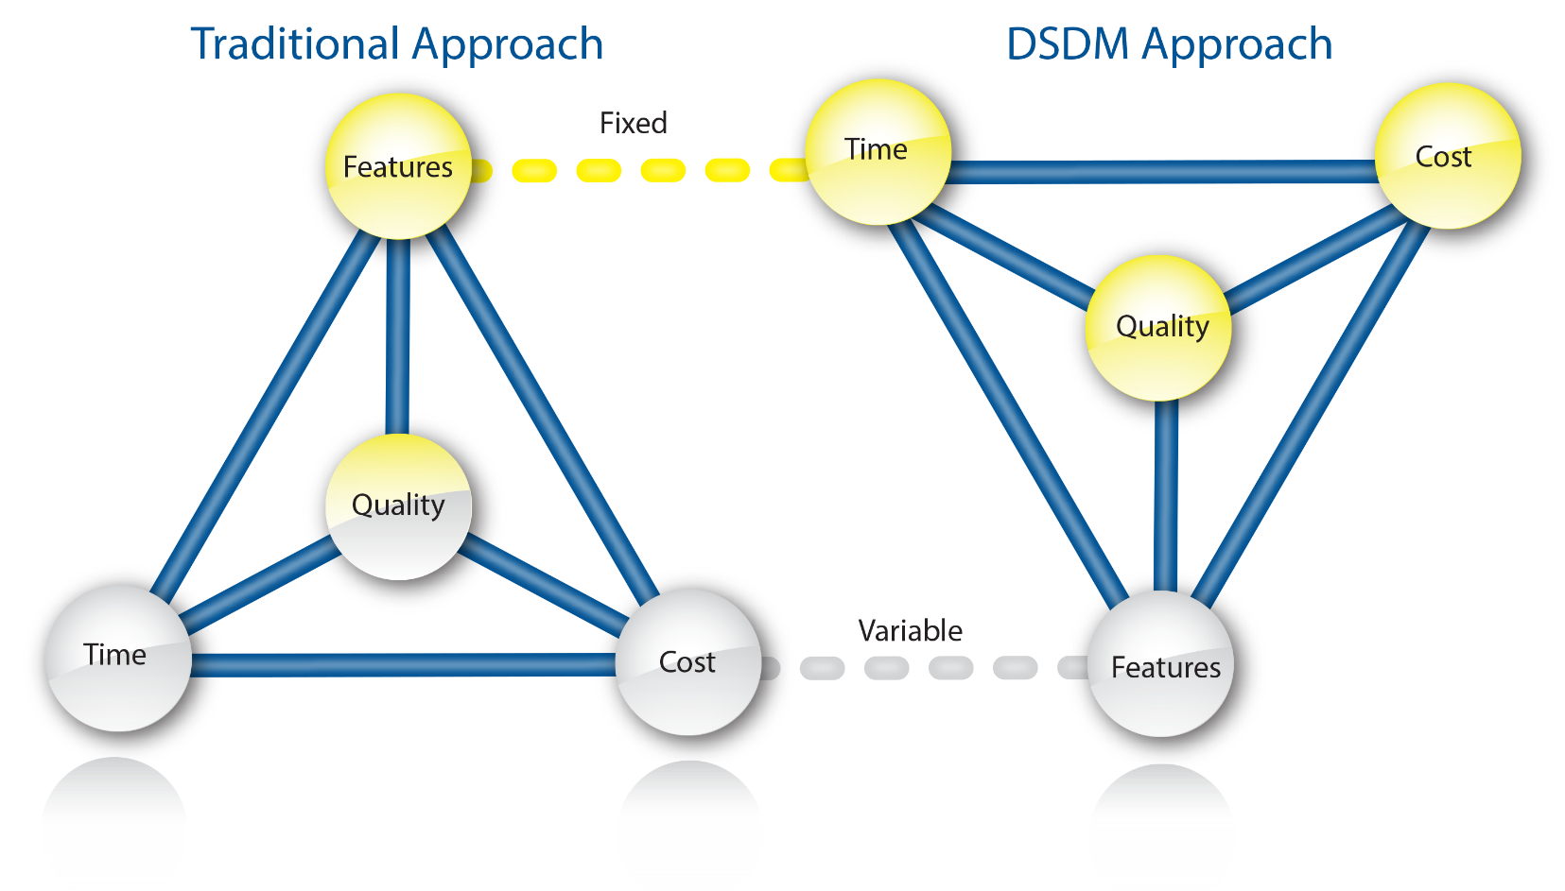
How does DSDM differ?
Traditional Approach
DSDM Approach
Source: Image from dsdm.org © 2016
Notes:
How does DSDM differ from traditional approaches?
DSDM works with all the Agile principles and enhances the process by ensuring that strong foundations are planned at the start of the project. These foundations are built around three perspectives: Business, Solution and Management. By setting clear foundations for the project looking at all three combined, it helps to ensure that there are no nasty surprises that compromise the project during development.

Slide 24
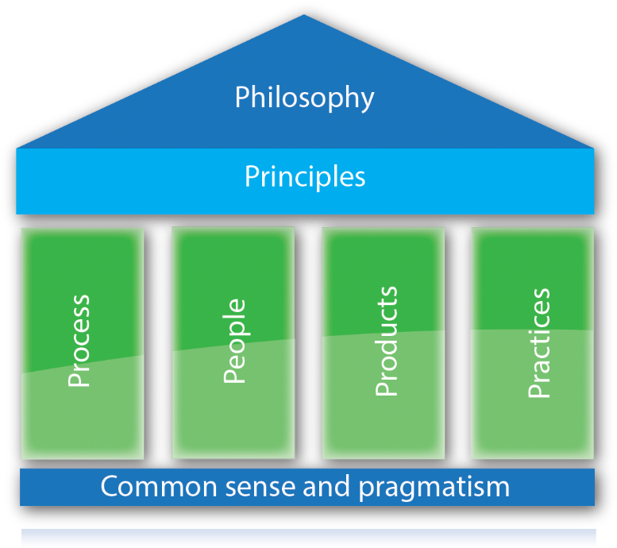
The Structure of DSDM
Source: Image from dsdm.org © 2016
Notes:
DSDM ATERN
Approach and Principles
ATERN S1 Approach
(C) DSDM Consortium 2007
DSDM Agile Project Framework 2014 is built on a combined Philosophy that combines the key principles of Agile Development with the four key components;
Process
People
Products
Practices
Each playing an equal role in ensuring that the project is delivered; on time, to cost, without compromising on quality.

Slide 25
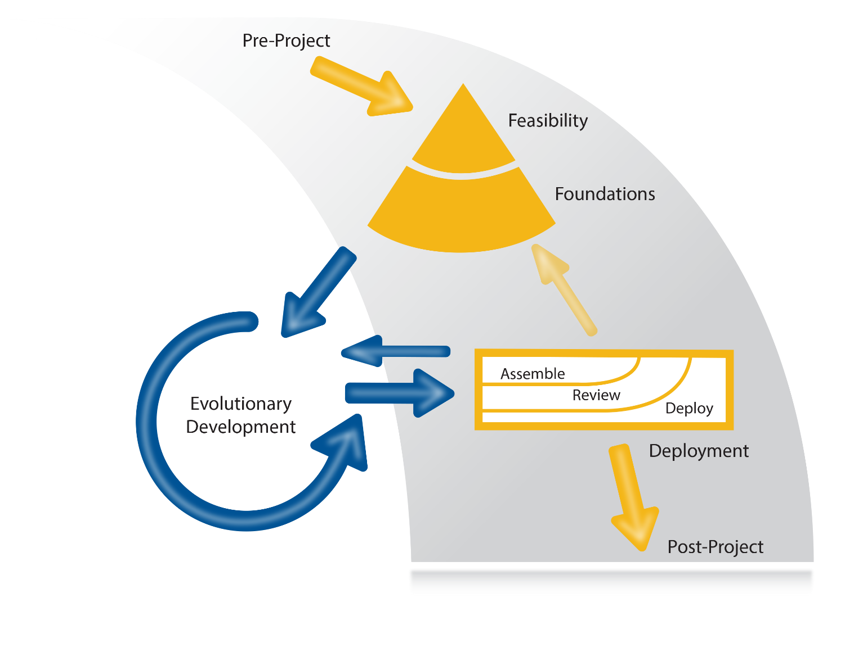
The Process
Source: Image from dsdm.org © 2016
Notes:
The Process is far more flexible than the Waterfall approach, and once the finely planned foundations are built the project can evolve and adapt until the final project is deployed.

Slide 26
Summary of Topic 1 Coverage
This first topic has:
  Provided an introduction to the structure and content of the Agile Development unit;
  Given the aim, scope and coverage of the unit;
  Introduced the history and key concepts of Agile, in comparison to the waterfall approach;
  Shown the structure and process of DSDM Agile Project Framework 2014
Notes:
NCC Education - Slide Master

Slide 27
Self Study Tasks – 1
Exercise 1: Familiarisation with DSDM
You should take the opportunity to familiarise yourself DSDM. Research the process in greater detail. Find at least ONE (1) case study documenting how it was applied and make notes relating to what you see as the benefits.
.

Slide 28
Self Study Tasks – 2
Exercise 2: Research
Work in a pair or a small group (max 3) to complete this task.
Focus on researching the following approaches; Scrum, FDD, Lean and XP. These were introduced in this lecture. You should also produce a 50-100 word summary of each approach in your own words, ready for discussion at the seminar session for this topic.

Slide 29
Suggested Reading List
  The DSDM Agile Project Framework. (2014). DSDM Agile Project Framework (2014 Onwards) Handbook. DSDM Consortium https://www.dsdm.org/resources/dsdm-handbooks/the-dsdm-agile-project-framework-2014-onwards (Last accessed 13th September 2016)
  The DSDM Consortium . (2008). DSDM Atern Handbook. 2nd Edition. DSDM Consortium https://www.dsdm.org/resources/dsdm-handbooks/dsdm-atern-handbook-2008 (Last accessed 13th September 2016)
Notes:
Suggested reading list. Students are to be encouraged to find additional reading materials and to share their sources with their peers.

Slide 30
Topic 1 – Introduction to the unit and an Overview of Agile
Any Questions?
Notes:
NCC Education - End Slide Master

